Slide 1

Health Insurance Application
Health
Insurance Application
Digitalization
of Business Process
Florian Büttiker
Oliver Freiermuth
Karimi Moahammad Ali
Pasquale Biafora

Slide 2

Agenda
AS-IS Situation
Customer Experience
Project targets and methodology
Digitalized Process
Comparison
Demo
Questions
6/7/18
2

Slide 3
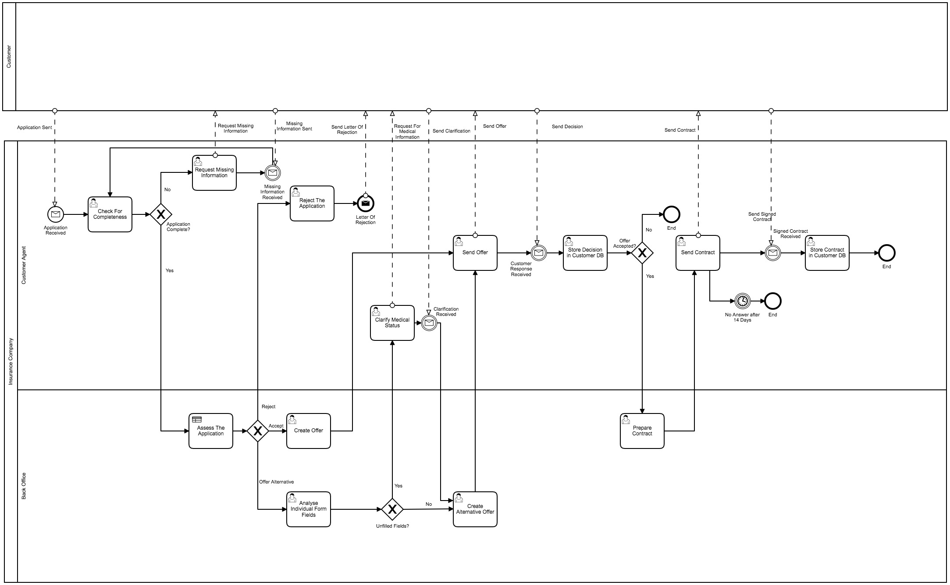
AS-IS Situation
6/7/18
3

Slide 4



Customer Experience
Individual consultancy
Personal Interaction
Only offline communication
No traceability
Misunderstanding could lead to call back
Very slow
Paper based and expensive process
Many mistakes (decision table is applied manually)
Office hours
6/7/18
4

Slide 5
Target - Driver for change
Be the fastest insurer from application to contract subscription for preferred customers
Define clear rules for the application procedure and premium calculation
Increase scalability and flexibility of the process
Free up time for employees to analyze critical customer applications
Reduce cost for printing and post office
Maintain critical decisions with personal interaction
Reduce incomplete applications
6/7/18
5

Slide 6

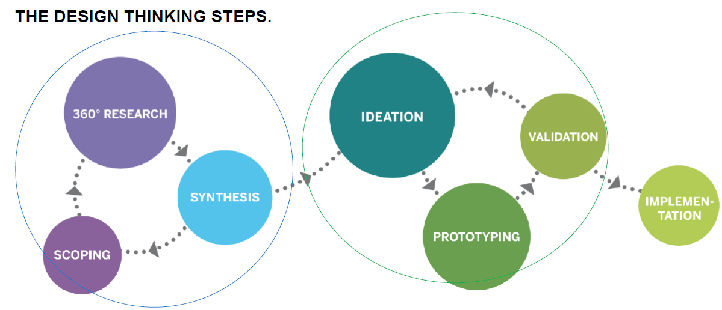
Way to target - Project Methodology
First steps to understand the problem:
AS-IS high level process definition
User journey (pain points)
Project targets
Rough TO-BE Process modelling
Scrum cycles:
Create customer interfaces
Automate decision
Integrate database
Integrate E-Mail services
Automated premium calculation
6/7/18
5

Slide 7
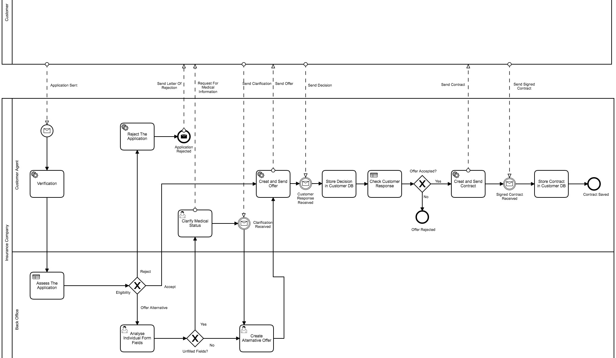
Digitalized Process
6/7/18
7

Slide 8

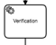
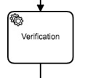

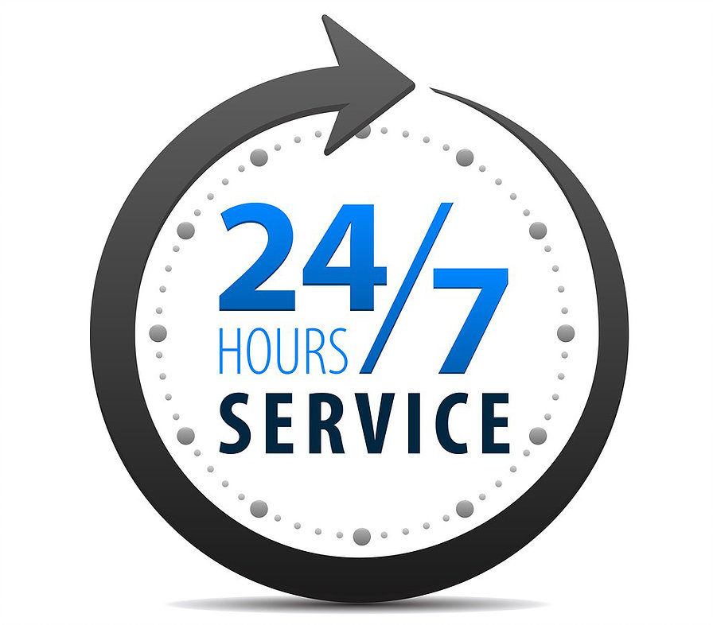
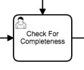
Comparison
Full automated "happy path" of the process
Process is flexible and scalable
Fully electronic process without any paper based documents
Personal interaction in difficult situations
No media breaks
Elimination of unnecessary tasks (e.g. data check)
Online-Process (24/7)
6/7/18
8

Slide 9

Demo
Picture source: Own Illustration
6/7/18
9
6/7/18
9

Slide 10

Questions

Slide 11

Thank you for your attention.
6/7/18
11

Slide 12
Source citation
All pictures are from: https://www.pexels.com/
All icons are from: https://www.flaticon.com/
6/7/18
12
6/7/18
12

